Slide 1

Introduction to Database Systems

Slide 2
Lecture Agenda-I Background of Database Management
Example of US continental airlines
Introduction
Basic concepts and definitions
Data
Data versus information
Metadata
Traditional file processing Systems

Slide 3
Lecture Agenda-II Introduction to Database Management Systems
History of Different data models
Entities Relationship data models
Relational databases
Object-based data models (Object-oriented and Object-relational)
Semi structured data model (XML)
Other older models

Slide 4
Case Study: US International Airline
The transformation of U.S. Continental Airlines from one of the lowest-ranked airlines to a highly admired global company is a remarkable case study in effective management, strategic planning, and the use of technology, particularly data warehousing. Here’s an overview of how this transformation occurred:

Slide 5
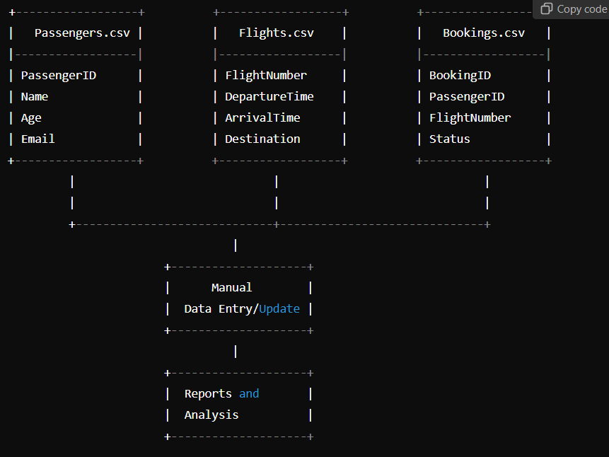
Diagram supporting the case study:

Slide 6
Explanation of the diagram:
Data Files:
Passengers.csv: Contains information about passengers, such as their ID, name, age, and email.
Flights.csv: Stores flight details, including flight numbers, departure times, arrival times, and destinations.
Bookings.csv: Tracks flight bookings, linking passengers to specific flights along with the status of their bookings.
Manual Data Entry/Update:
Data is often entered manually into these files, which can lead to errors and inconsistencies.
Updates require reading the entire file, making changes, and rewriting the file. This process is time-consuming and error-prone.
Reports and Analysis:
Generating reports requires extracting data from multiple files, often leading to complex queries and inefficient data retrieval.
The system lacks real-time analytical capabilities, meaning insights are often delayed, making it difficult to respond promptly to operational issues or customer complaints.

Slide 7
Example of US continental airlines
U.S Continental airlines was in trouble, lowest ranked airline Company a decade before 2004.
Complaints of mishandled baggage, customer complaints, and overbooking.
Speculation of 3rd time bankruptcy
Had 10 CEOs in 10 years
Today it is the most admired Global company.
Implemented data warehouse,
that supported the company’s business strategy, dramatically improving customer service and operations
creating cost savings
and generating revenue

Slide 8
Example of US continental airlines contd..
Company has integrated:
revenue
flight schedule
customer
inventory
and security data as part of the data warehousing project
After September 11, company was able to work with FBI to determine whether the terrorist in FBI list were attempting to board the company flights.

Slide 9
File Processing System -I
File processing system refers to the first computer-based approach of handling the commercial or business applications.
Collection of programs that perform services for the end users. E.g. reports.
Each program defines and manages its own data.
This approach met the data processing needs of individual department’s needs.

Slide 10
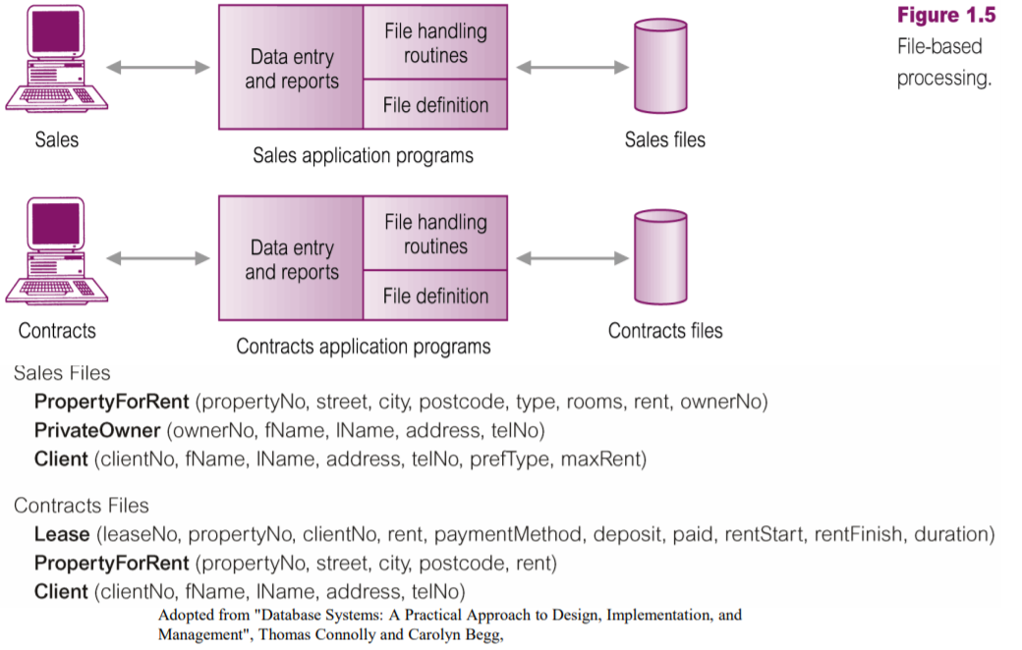
File Processing System- II

Slide 11
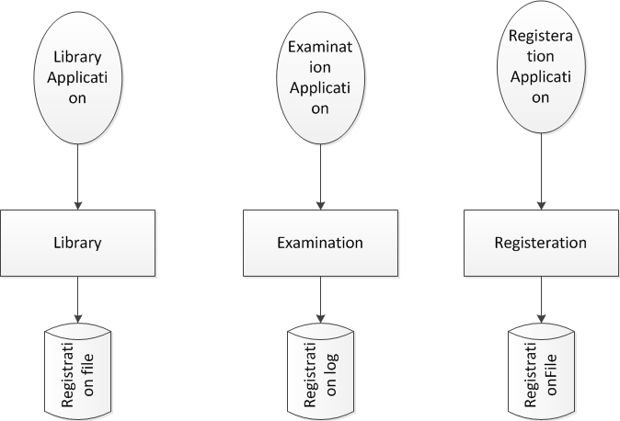
File Processing System-III

Slide 12
File Processing System-IV
It is also called a replacement of the manual file system.
In this system data is stored in permanent system files.
Different application programs are written to extract data from these files and to add record to these files.
No overall map, plan or model guided application growth.

Slide 13
Disadvantages of File Processing -I
Program-Data Dependence
file descriptions are stored within each database application program that accesses a given file.
any change to a file structure requires changes to the file descriptions for all programs that access the file.
This makes a change very painful or problematic for the designers or developers of the system.

Slide 14
Disadvantages of File Processing-II
Each application programmer must maintain their own data
Each application program needs to include code for the metadata of each file
Each application program must have its own processing routines for reading, inserting, updating and deleting data
Lack of coordination and central control
Non-standard file formats

Slide 15
Disadvantages of File Processing-III
Figure 1

Slide 16
Disadvantages of File Processing-IV
Duplication of Data
Different systems/programs have separate copies of the same data
Waste of space to have duplicate data
Causes more maintenance headaches
The biggest problem:
When data changes in one file, could cause inconsistencies
Compromises data integrity

Slide 17
Disadvantages of File Processing-V
Limited Data Sharing
different systems of an organization are using some common data then rather than storing it once and sharing it.
This creates the problem of redundancy or wastage of storage and on the other hand the problem on inconsistency.
The change in the data in one system sometimes is not reflected in the same data stored in other system.
different systems in organization; store different facts about same thing.

Slide 18
Disadvantages of File Processing-VI
Lengthy Development Times
Each application requires that the developer essentially start from scratch by designing new file formats and descriptions.
writing the file access logic for each new program.

Slide 19
Disadvantages of File Processing-VII
Excessive Program Maintenance
80% of information systems budget might be devoted to program maintenance due to the preceding factors discussed in detail.
NOTE: the disadvantages discussed for file processing system can also be the limitations of databases, if an organization does not apply the database approach.

Slide 20
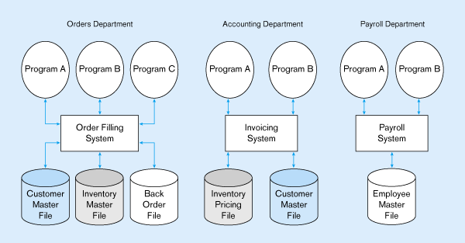
Figure 1-2 Three file processing systems at Pine Valley Furniture
Duplicate Data

Slide 21
What is program in above example?
In a traditional file processing system like the one used at Pine Valley Furniture Company, each application typically consists of multiple programs, each serving specific purposes within that system. Here’s a breakdown of the potential roles of programs within each application:
Order Filling System
Program A: Order Entry This program allows users to enter new customer orders into the system, checking inventory levels and customer details.
Program B: Order Processing This handles the logic of processing orders, including checking for available inventory and updating stock levels accordingly.
Program C: Order Tracking This tracks the status of orders (e.g., fulfilled, backordered) and may generate notifications for customers or internal staff.

Slide 22
SOLUTION: The DATABASE Approach
Requires a Database Management System (DBS)
The database management system (DBS), on the other hand is the software or tool that is used to manage the database and its users.

Slide 23
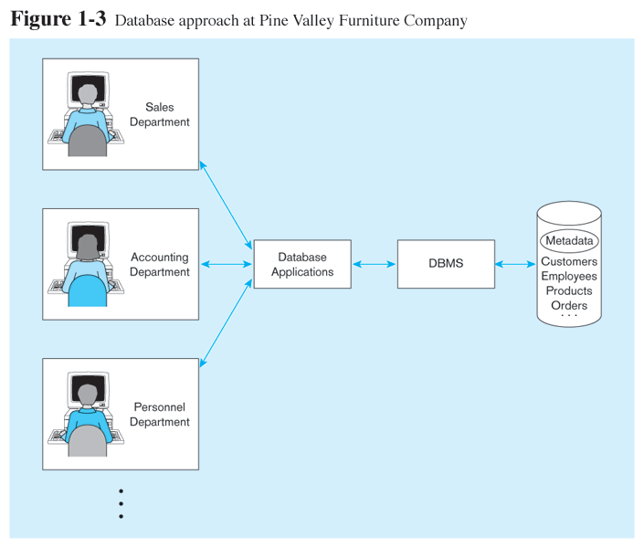
Database Management System
A software system that is used to create, maintain, and provide controlled access to user databases

Slide 24
Database Management System contd..
DBMS manages data resources like an operating system manages hardware resources

Slide 25
Introduction to Databases
Enormous growth in database applications
Uses of databases.
Derived knowledge for competitive advantage.
For example
detailed sales databases can be mined to determine customer buying patterns as a basis for advertising and marketing campaigns.

Slide 26
Introduction to Databases contd..
Organizations embed procedures called alerts in databases to warn of unusual conditions, such as:
impending stock shortages
opportunities to sell additional products
to trigger appropriate actions

Slide 27
Introduction contd..
Many organizations have incompatible databases that were:
developed to meet immediate needs rather than based on a planned strategy
Enormous amounts of data are trapped in older, “legacy” systems,
the data are often of poor quality.

Slide 28
Introduction contd..
New skills are required to design and manage data warehouses and to integrate databases with Internet applications.
There is a shortage of skills in areas such as database analysis, Database design and data administration

Slide 29
Introduction contd..
As information systems professionals,
you must be prepared to:
analyze database requirements
design and
implement databases within the context of information systems development.

Slide 30
Introduction contd..
You also must be prepared to consult with end users
Show them how they can:
use databases to build decision support systems
And execute information systems for competitive advantage

Slide 31
Definitions
Database:
organized collection of logically related data
Database stores data
Data:
referred to facts concerning objects and events that could be
recorded and stored on computer media

Slide 32
Example of Databases
Contacts list on Smart Phones
Youtube
Utility bills such as PTCL bills, Electricity bills etc.
Hospitals databases
Purchases from super market
Purchase using your credit card
Booking a holiday at the travel agents
Using the local library

Slide 33
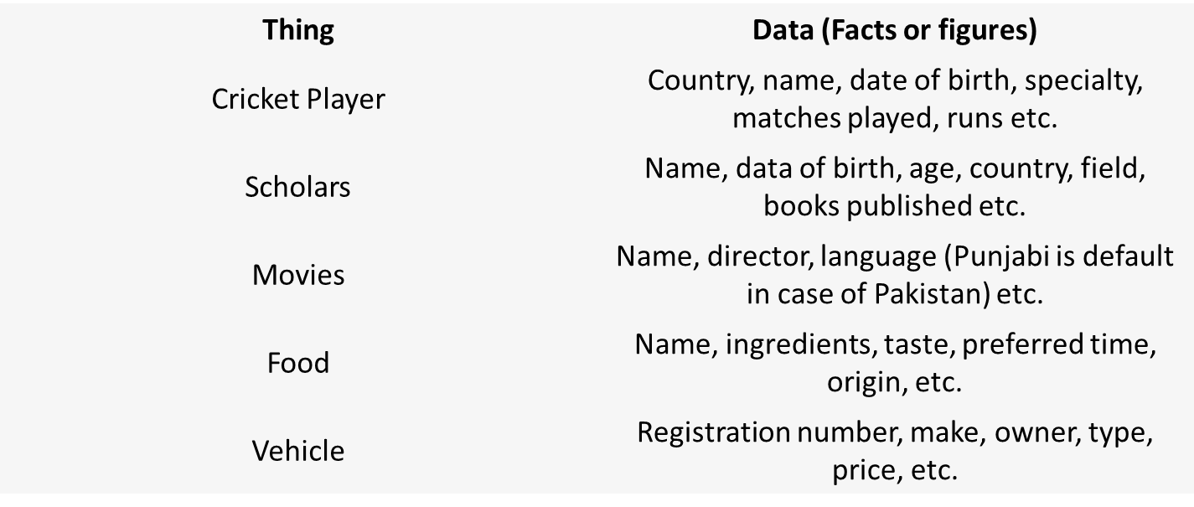
Example of Data

Slide 34
Types of data
Structured: numbers, text, dates
Example
Students regd. No, name, contact No
Unstructured: images, video, documents

Slide 35
Definitions:
Information:
data that have been processed to increase knowledge of the person who uses the data.
Example
Consider the following facts

Slide 36
Definitions contd..
Baker, Kenneth D. 324917628
Doyle, Joan E. 476193248
Finkle, Clive R. 548429344
Lewis, John C. 551742186
McFerran, Debra R. 409723145

Slide 37
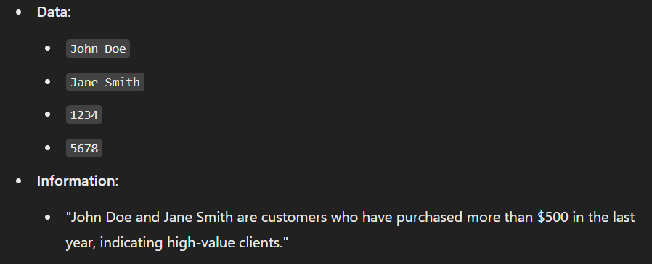
Example of Data Vs Information

Slide 38
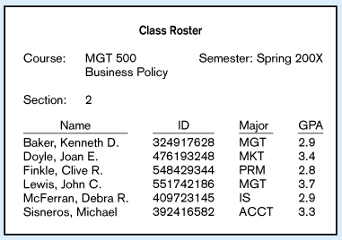
Figure 1-1a Data in Context
Context helps users understand data

Slide 39
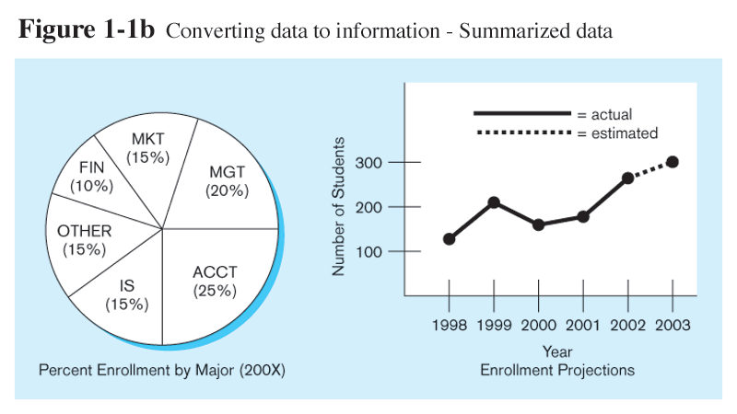
Graphical displays turn data into useful information that managers can use for decision making and interpretation

Slide 40
Definitions contd..
Metadata:
data that describes the properties or characteristics of end user data and context of that data.
Data about data
Example
By adding a few additional data items and providing some structure.
we recognize a class roster for a particular course.

Slide 41
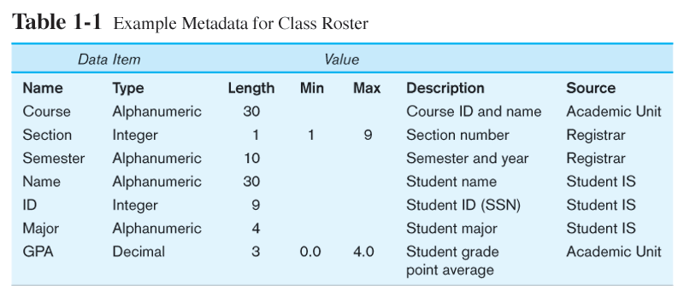
Descriptions of the properties or characteristics of the data, including data types, field sizes, allowable values, and data context

Slide 42
The DATABASE Approach
Data models:
capture the nature of and relationships among data
and are used at different levels of abstraction as a database is conceptualized and designed.
The effectiveness and efficiency of a database is directly associated with the structure of the database.
Various graphical systems exist that convey this structure and are used to produce data models.

Slide 43
History of data models
Entity-Relationship data model (mainly for database design)
Relational model
Object-based data models (Object-oriented and Object-relational)

Slide 44
The DATABASE Approach contd..
Semi structured data model (XML)
Other older models:
Network model
Hierarchical model

Slide 45
Entity Relationship Data model-I
A data model is made up of entities and relationships.
Entities
Entity: a “thing” or “object” in the enterprise that is distinguishable from other objects
Described by a set of attributes
Example
CUSTOMER, ORDER
Attribute: Customer Name, Address, Order ID

Slide 46
Entity Relationship Data model-II
Relationships
relationship between entities that exists in organizational data.
Different types of relationships exist.
One to many(1:M)
Many to many (M:N)

Slide 47
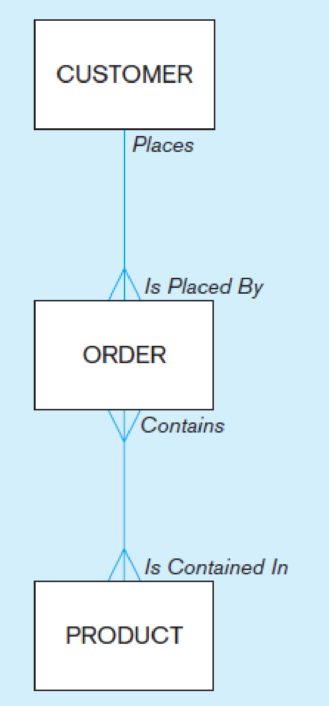
Entity Relationship Data model-III
an entity-relationship diagram:

Slide 48
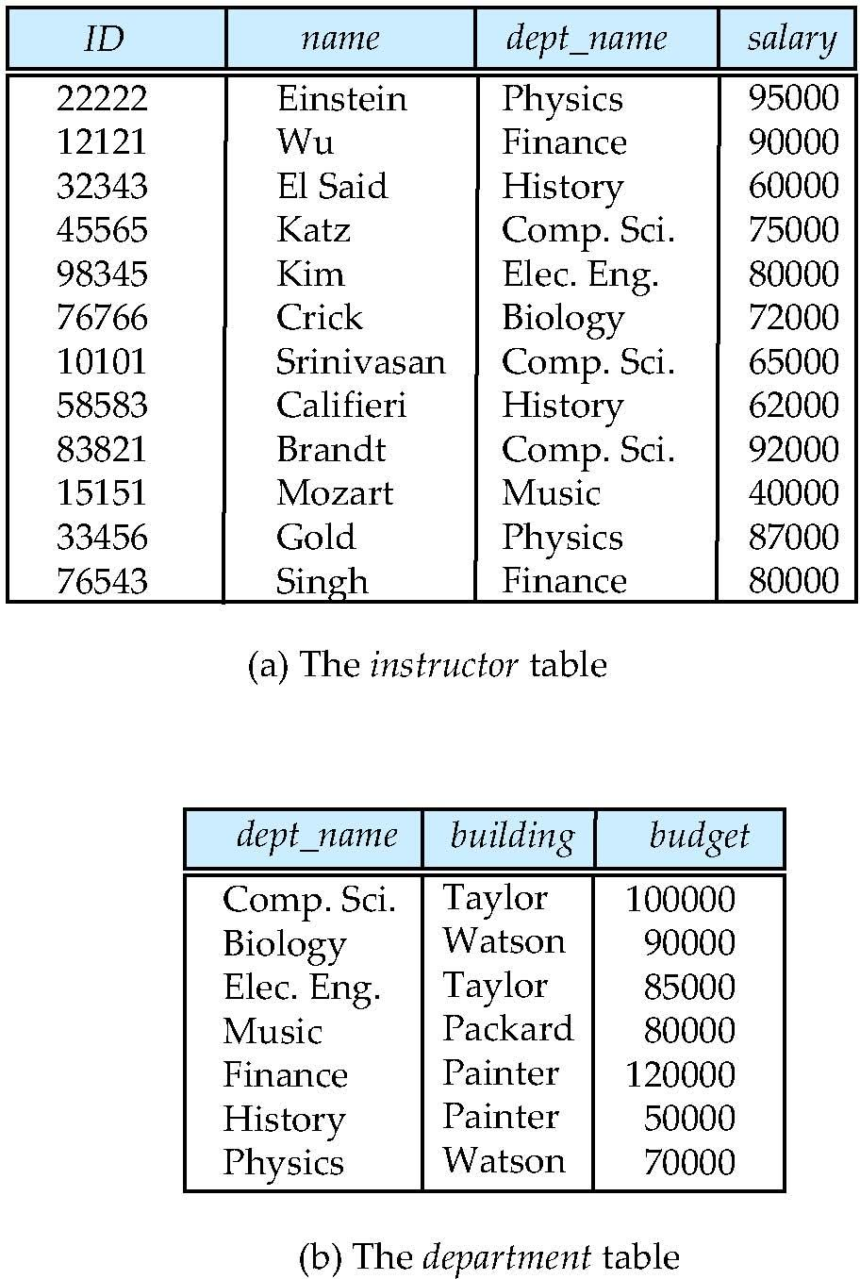
Relational Data Model
Columns
Example of tabular data in the relational model
Rows
Notes:
‹#›

Slide 49
Oracle versus SQL Server
Leiba compares SQL Server to Oracle along the following lines:Platform dependency (Guess who wins here?)
Locking and concurrency
Performance & tuning
Object Types
Procedural languages (PL/SQL vs. T-SQL)
Clustering Technology
Reliability

Slide 50
Summary
Importance of database has been increased.
Database is organized collection of logically related data.
File processing systems were used, which were replaced by modern DBMS.
Database management system helps us to create and maintain a database.

Slide 51
References
http://www.dba-oracle.com/oracle_tips_oracle_v_sql_server.htm
https://db-engines.com/en/system/Microsoft+SQL+Server%3BOracle

